Slide 1

MINI PROJECT 1-B
A.Y-2023-2024
(Fitness and Activity Manager using Python)
Monish Mudaliar-22107027
Siddhesh N Patil-22107019
Atharva Nimkar-22107025
Chinmay Pawaskar-22107066
Computer Science and Engineering
( Data Science )
Project Guide
Ms.Aavani N
Notes:
‹#›

Slide 2
Outline
Introduction
Literature Survey of the existing systems
Limitations of the existing systems
Problem statement
System Design
Technologies and methodologies
Implementation
Conclusion
References
Notes:
‹#›

Slide 3
Introduction
In an era where health and fitness are paramount, staying informed about your progress and adapting to changing circumstances can make all the difference.
The Fitness and Activity Manager App achieving your fitness goals has never been easier or more enjoyable.
Motivation:-
Health and Well-being: The primary motivation behind the fitness and activity manager project is to promote health and well-being among individuals. Regular physical activity has been proven to have numerous health benefits.
Lifestyle Improvement: Many people struggle to maintain a consistent fitness routine due to busy schedules, lack of motivation, or access to resources. By providing a convenient and accessible platform for tracking fitness activities,the fitness and activity manager app aims to empower individuals to make positive lifestyle changes and improve their overall health and fitness levels.
Notes:
‹#›

Slide 4
Objective
To develop a user-friendly fitness application using the Tkinter library for graphical user interface (GUI). The app will feature an intuitive interface allowing users to effortlessly navigate through various sections, log their workouts.
To Incorporate the Pillow library to provide dynamic visual demonstrations of exercises within the fitness app, enhancing user comprehension and ensuring proper form and technique during workouts
To Implement SQL database integration to securely store and manage user data within the fitness app.

Slide 5
Literature Survey of the existing system
Sr.No | Year of Publication | Author(S) | Title | Observation
1. | 7 August 2023 | Yasmeen Anjeer Alshehhi , Mohamed Abdelrak, Ben Joseph Philip, Alessio Bonti. | Understanding User Perspectives on Data Visualization in mHealth Apps: A Survey Study. [1] | Users are primarily motivated by curiosity and utility, such as progress tracking, when using data visualizations. We observe these efforts can lead to more effective data visualizations that enhance user experience and engagement.

Slide 6
Literature Survey of the existing system
Sr.No | Year of Publication | Author(S) | Title | Observation
2. | 16 August 2022 | Fotos Frangoudes, Maria Matsangidou , Eirini C. Schiza, Kleanthis Neokleous , Constantinos S. Pattichis | Assessing Human Motion During Exercise Using Machine Learning: A Literature Review. [2] | We observe, guidelines for ML solutions for HMQA(Human Motion Quality Assessment ) aim to enhance the development and usability of assessment tools. Also we see , Assessments should be easy to interpret for users and user avoid biases based on training data.
Notes:
‹#›

Slide 7
Literature Survey of the existing system
Sr.No | Year of Publication | Author (S) | Title | Observation
3. | 15 January 2018 | Edith Talina Luhanga ,Akpa Akpro Elder Hippocrate, Hirohiko Suwa, Yutaka Arakawa, Keiichi Yasumoto | Identifying and Evaluating User Requirements for Smartphone Group Fitness Applications. [3] | We observe MyFitnessTeam app , developed based on user requirements, demonstrated significant improvements in adherence to physical activity and healthy eating. Also we see, recommendation aim to enhance in-group collaboration and interactions, fostering improved user engagement and adherence.
Notes:
‹#›

Slide 8
Limitations of existing systems
Some systems may adopt a generic approach that doesn't cater to individual user differences.
Users with unique health conditions or preferences may find limited support .
Notes:
‹#›

Slide 9
Problem statement
“The current problem lies in inefficient data visualization methods in mHealth apps, hindering users' comprehension of health metrics. We aim to address this challenge by proposing a novel approach that integrates user-centric design principles.”
Solution Approach:
To address these challenges, the fitness manager app aims to provide a comprehensive solution that empowers users to take control of their fitness journey and achieve their health goals with confidence.

Slide 10
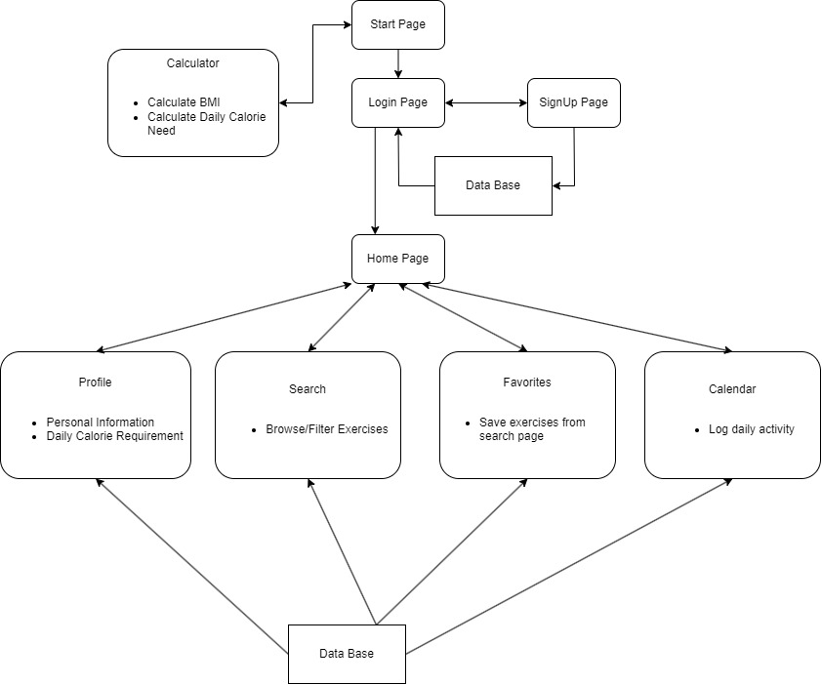
System Design
Notes:
‹#›

Slide 11
Technologies and methodologies
Frontend Technology:
Python(3.8.16)
Tkinter(8.6.14): Base of GUI Application.
Pillow(10.3.0):To display images on labels and buttons.
Backend Technology:
SQL(8.2.0) : Structured storage for user login and details.
Notes:
‹#›

Slide 12
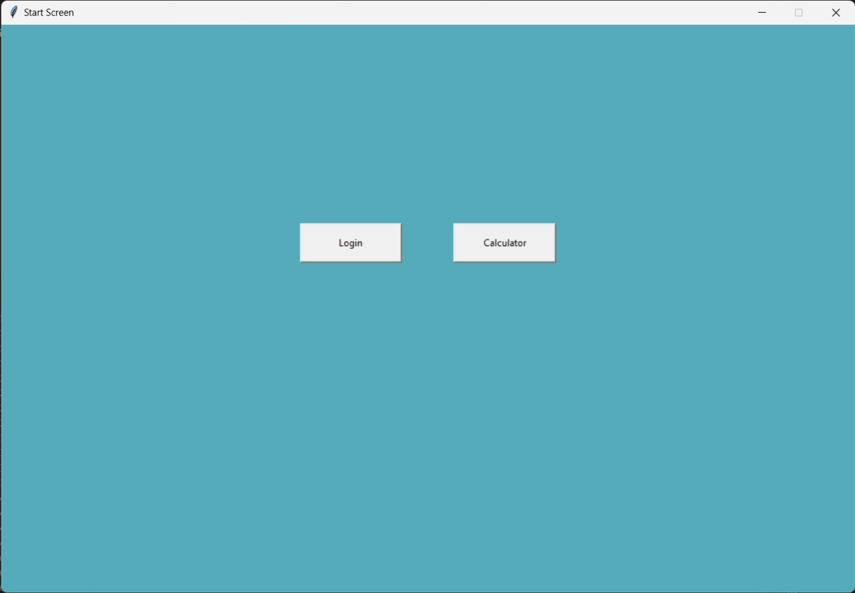
Implementation
Notes:
‹#›

Slide 13
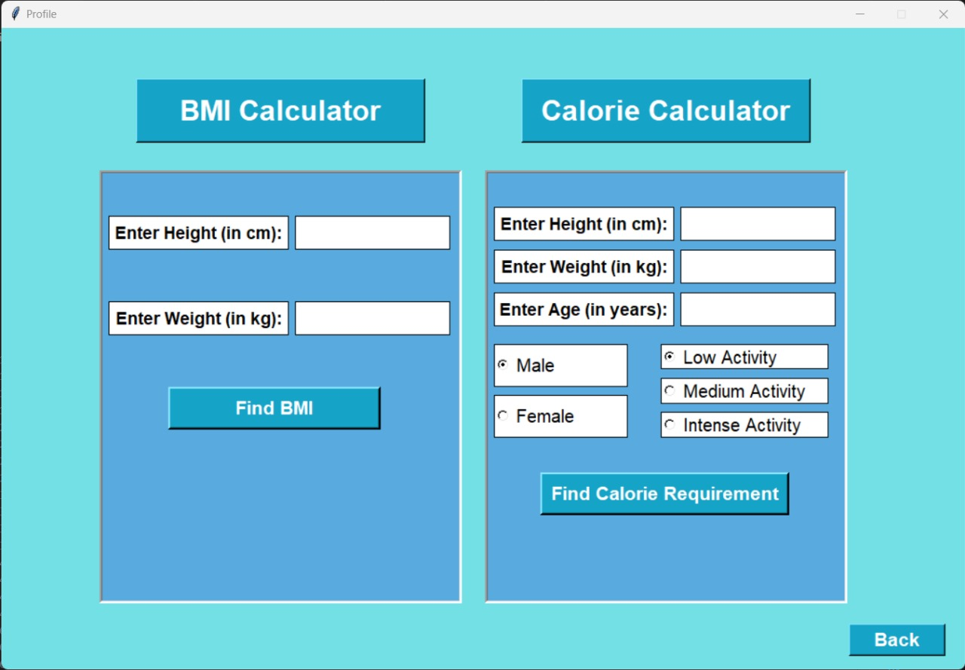
Implementation
Notes:
‹#›

Slide 14
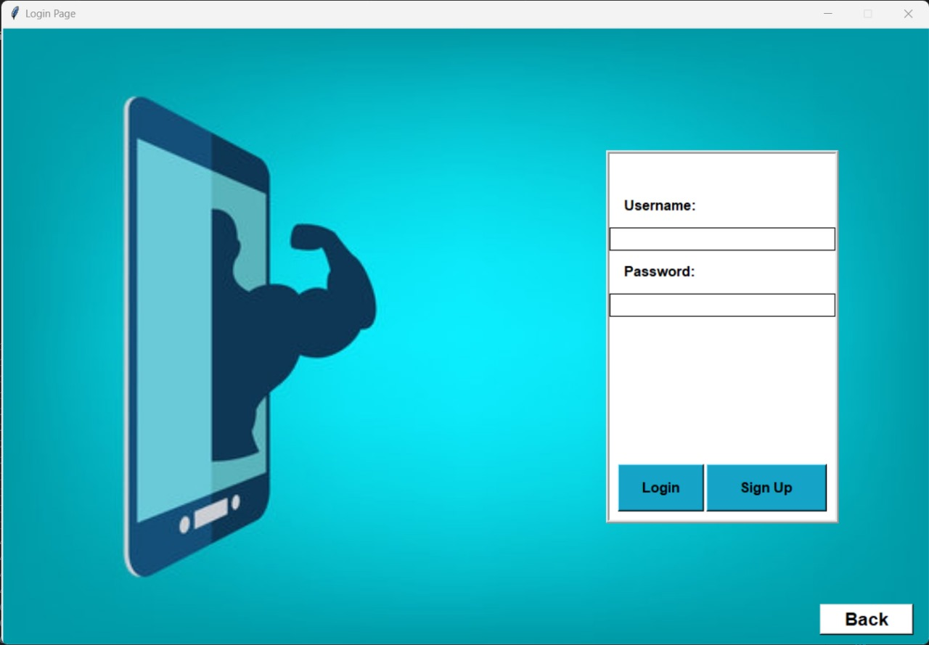
Implementation
Notes:
‹#›

Slide 15
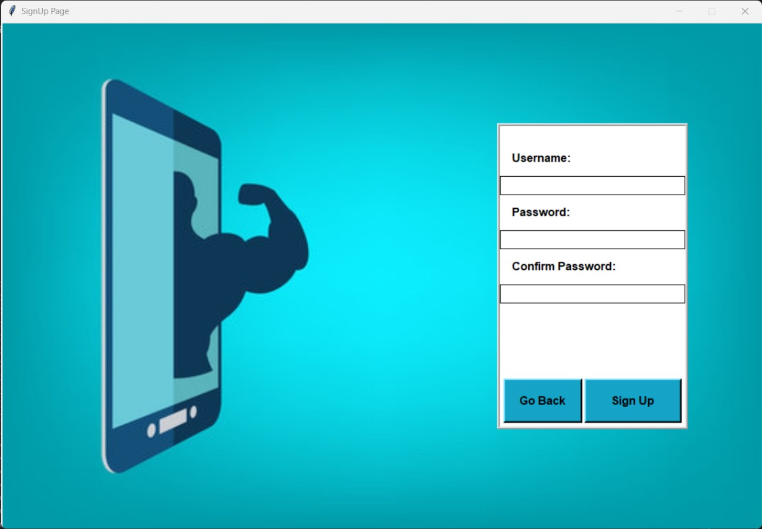
Implementation
Notes:
‹#›

Slide 16
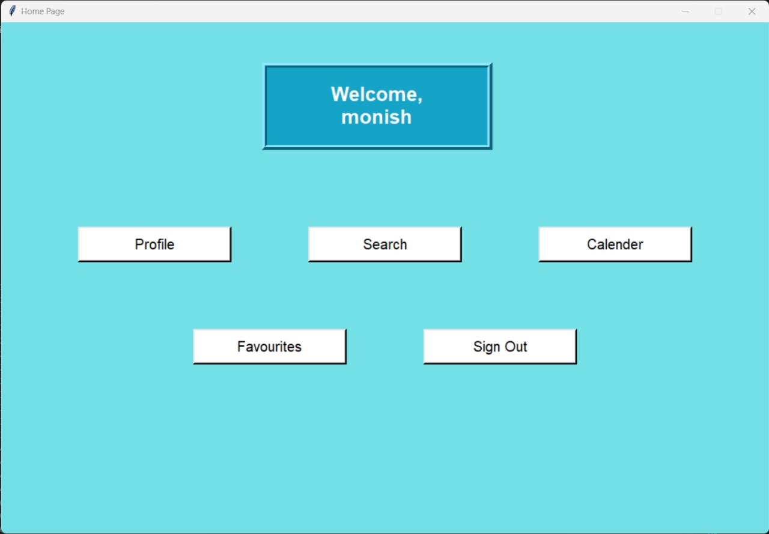
Implementation
Notes:
‹#›

Slide 17
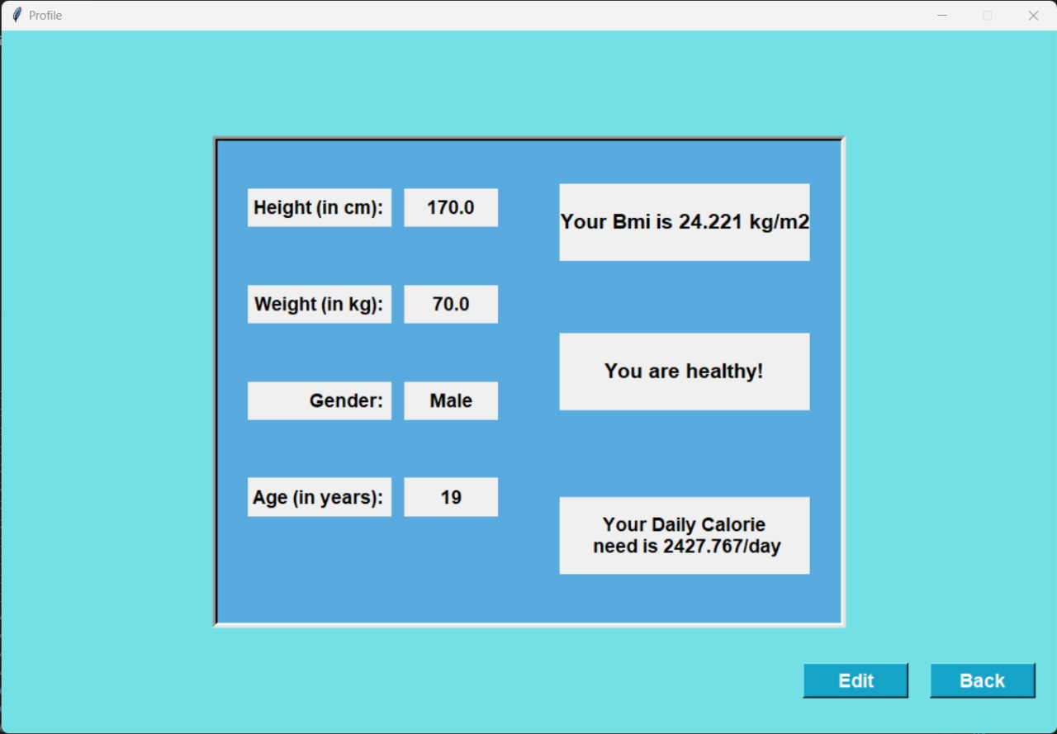
Implementation
Notes:
‹#›

Slide 18
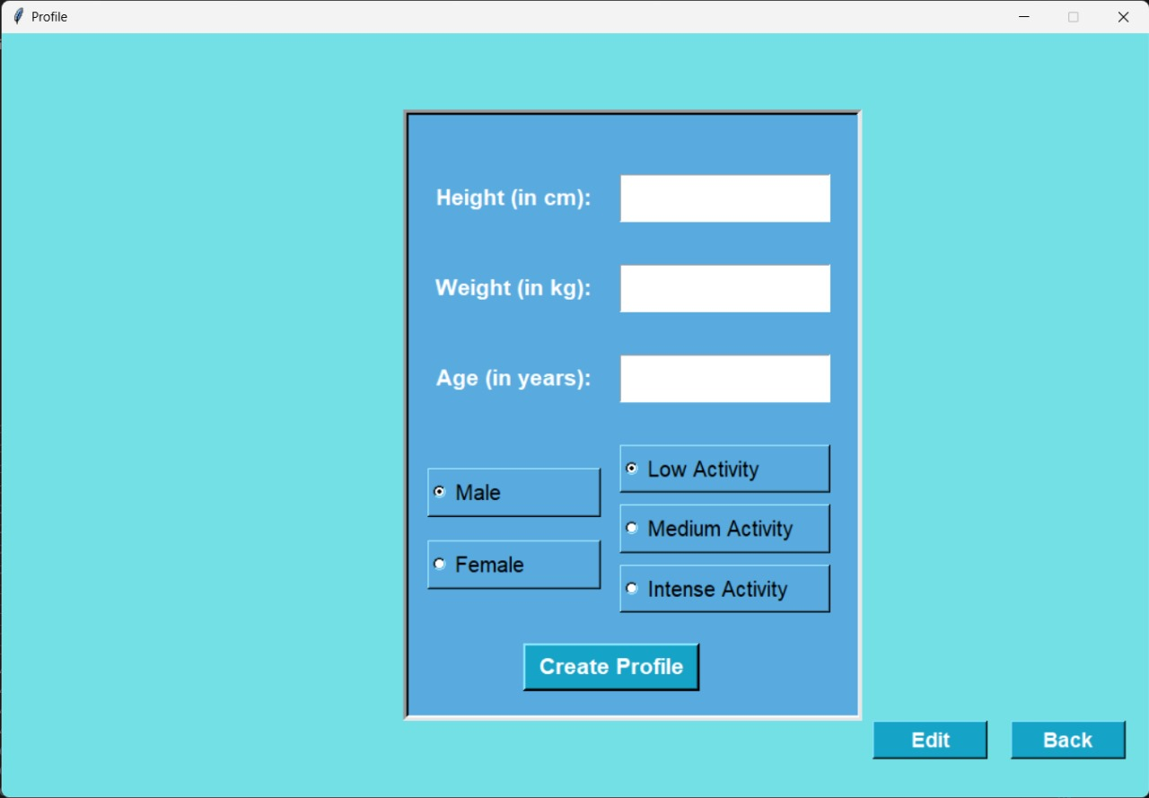
Implementation
Notes:
‹#›

Slide 19
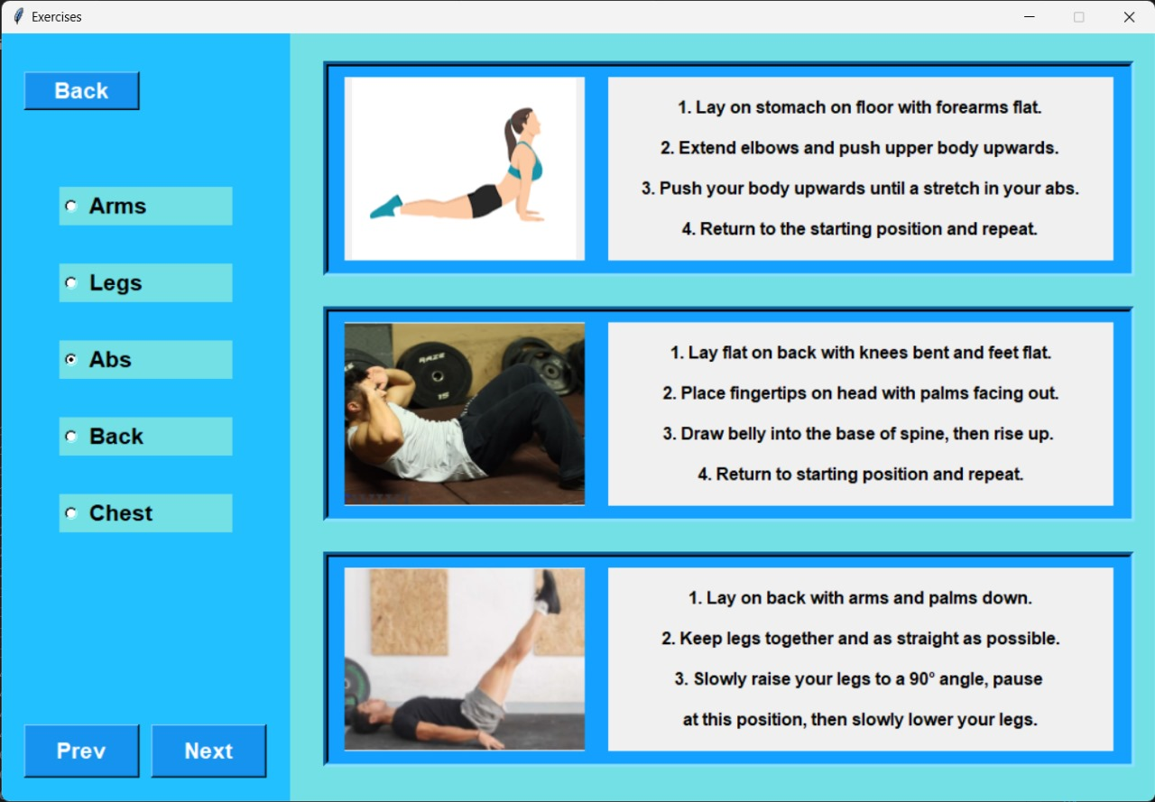
Implementation
Notes:
‹#›

Slide 20
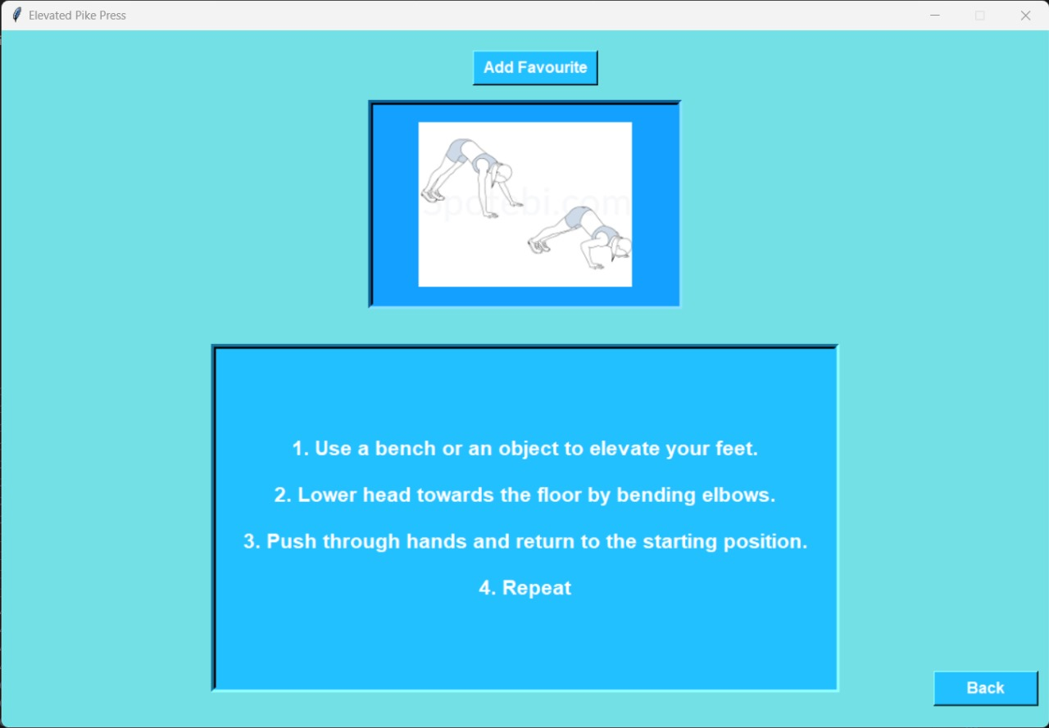
Implementation
Notes:
‹#›

Slide 21
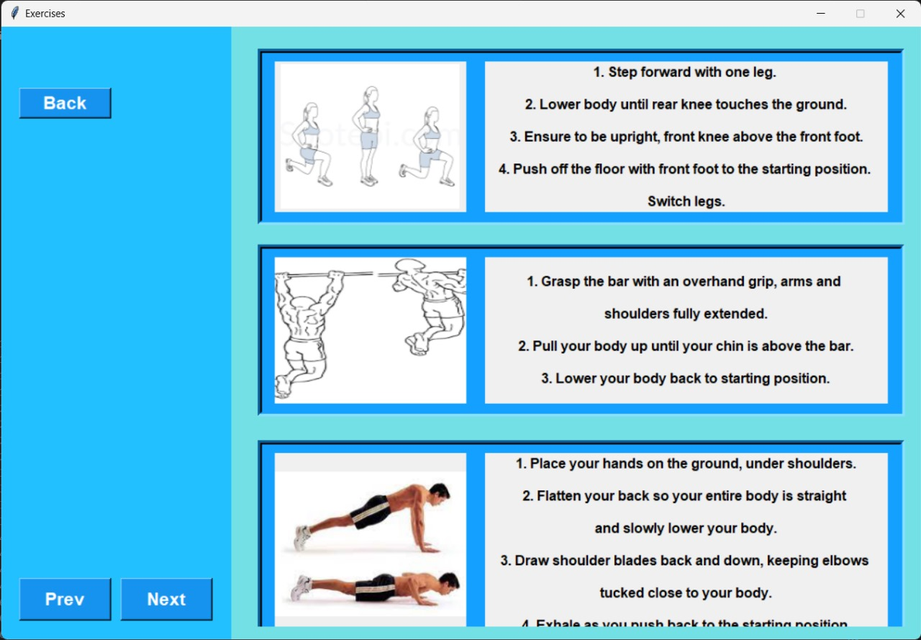
Implementation
Notes:
‹#›

Slide 22
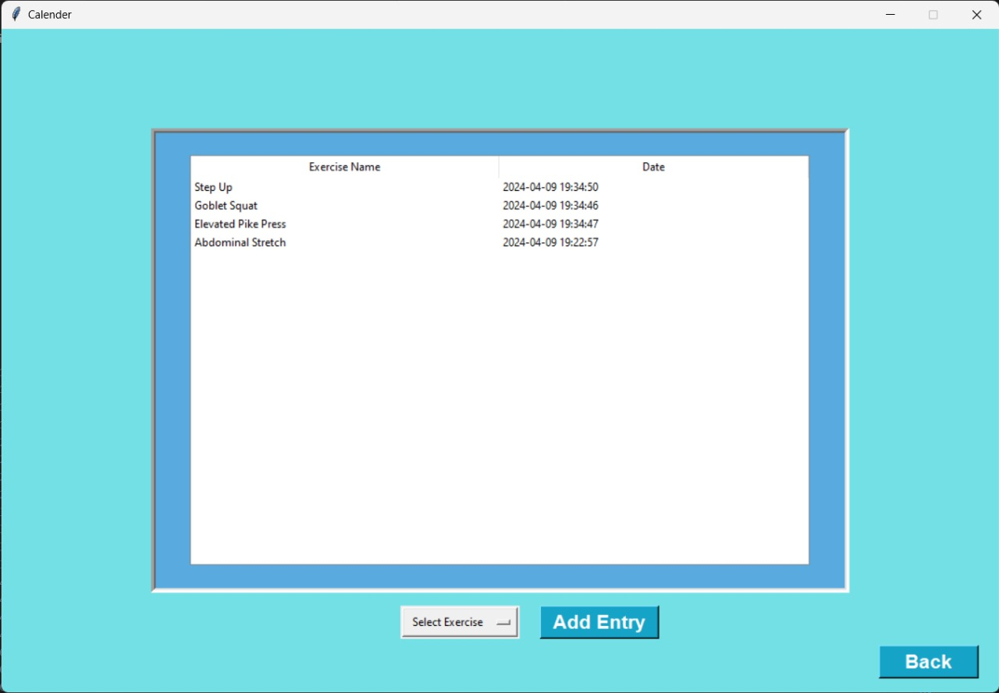
Implementation
Notes:
‹#›

Slide 23
Conclusion
This review highlights the diversity in Fitness and Activity Managers, offering users a range of options to find the one that best suits their needs and preferences.
The simplicity and accessibility of our basic fitness app provide users with easy access to exercise demonstrations, guiding them through various workouts with clear picture instructions.
The calendar feature allows users to track their exercise, promoting consistency and accountability in their fitness journey.
Notes:
‹#›

Slide 24
References
[1] Yasmeen Anjeer Alshehhi , Mohamed Abdelrak, Ben Joseph Philip, Alessio Bonti,“Understanding User Perspectives on Data Visualization in mHealth Apps: A Survey Study.” , IEEE Access Research Article, Accepted For Publications, 12 July 2023.
[2]Fotos Frangoudes, Maria Matsangidou , Eirini C. Schiza, Kleanthis Neokleous , Constantinos S. Pattichis, “Assessing Human Motion During Exercise Using Machine Learning: A Literature Review.” , IEEE Access Survey, Accepted For Publications, 5 July 2022.
[3] Edith Talina Luhanga ,Akpa Akpro Elder Hippocrate, Hirohiko Suwa, Yutaka Arakawa, Keiichi Yasumoto, “ Identifying and Evaluating User Requirements for Smartphone Group Fitness Applications.” , IEEE Access Special Section on Human-Centered Smart System and Technologies, Accepted For Publications, 3 January 2018.
Notes:
‹#›

Slide 25
Thank You...!!
Notes:
‹#›

